Slide 1
Put the game into PLAY MODE by clicking F5 on your computer keyboard.
Award points by clicking the check mark. Each click is worth $100. So, if a team wins a $400 question, click their team’s contestant four times. Click ESC to escape.

Slide 2
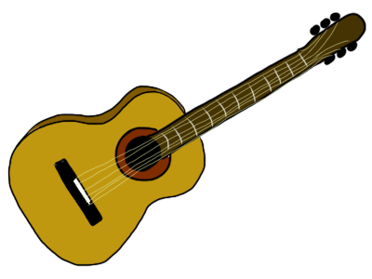
String Instruments – $100
Name the instrument.

Slide 3
String Instruments – $100
Name the instrument.
guitar

Slide 4
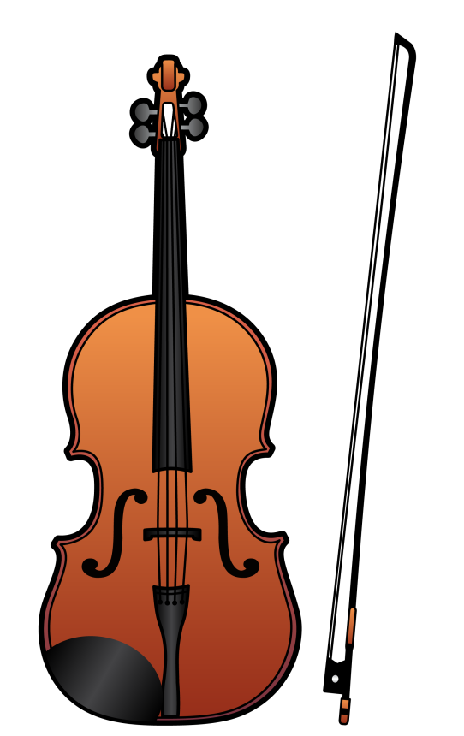
String Instruments – $200
Name the instrument.

Slide 5
String Instruments – $200
Name the instrument.
violin

Slide 6
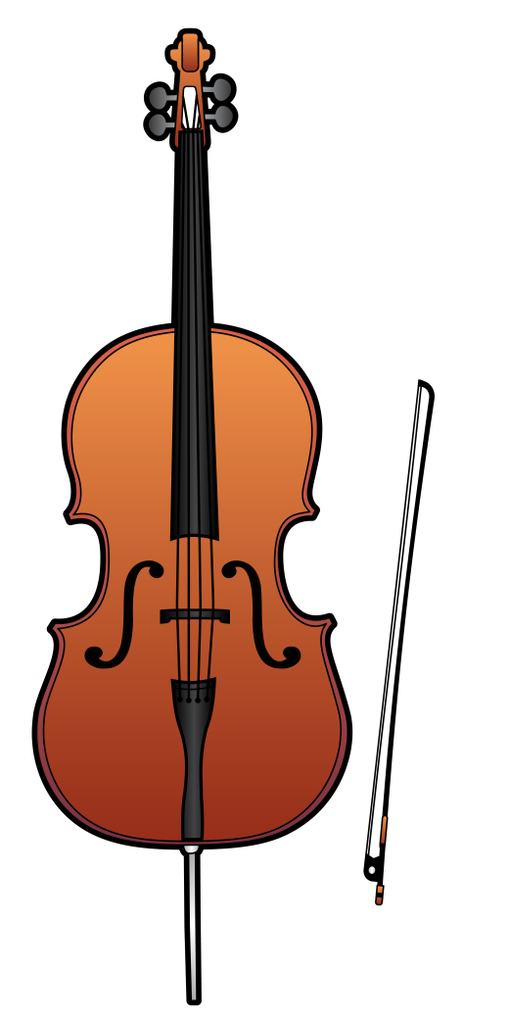
String Instruments – $300
Name the instrument.

Slide 7
String Instruments – $300
Name the instrument.
cello

Slide 8
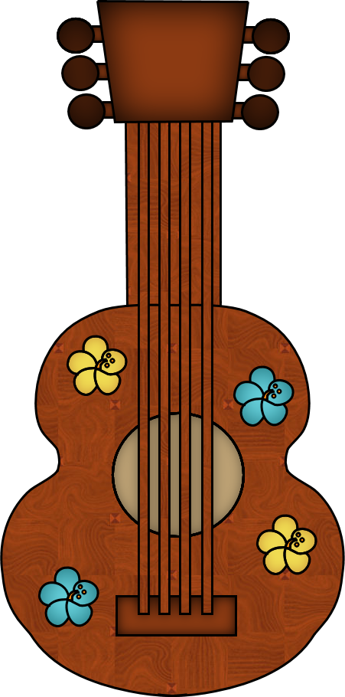
String Instruments – $400
Name the instrument.

Slide 9
String Instruments – $400
Name the instrument.
ukulele

Slide 10
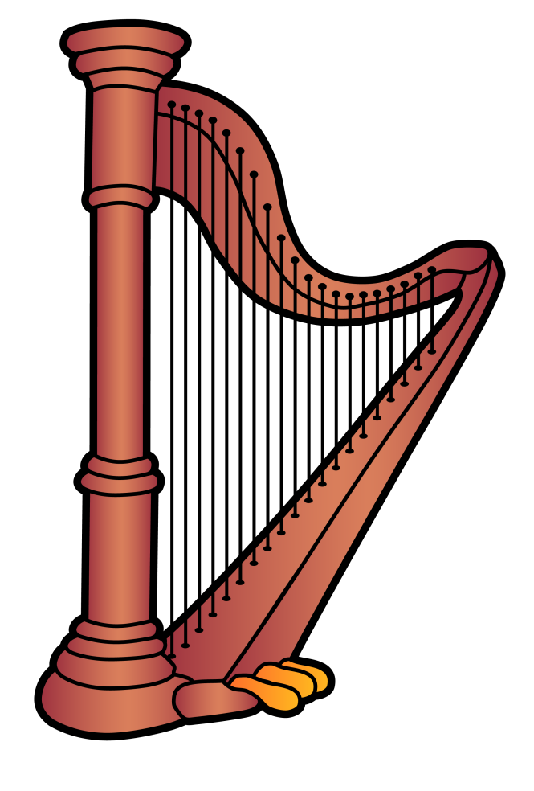
String Instruments – $500
Name the instrument.

Slide 11
String Instruments – $500
Name the instrument.
harp

Slide 12
Woodwind Instruments – $100
Name the instrument.

Slide 13
Woodwind Instruments – $100
Name the instrument.
flute

Slide 14
Woodwind Instruments – $200
Name the instrument.

Slide 15
Woodwind Instruments – $200
Name the instrument.
clarinet

Slide 16
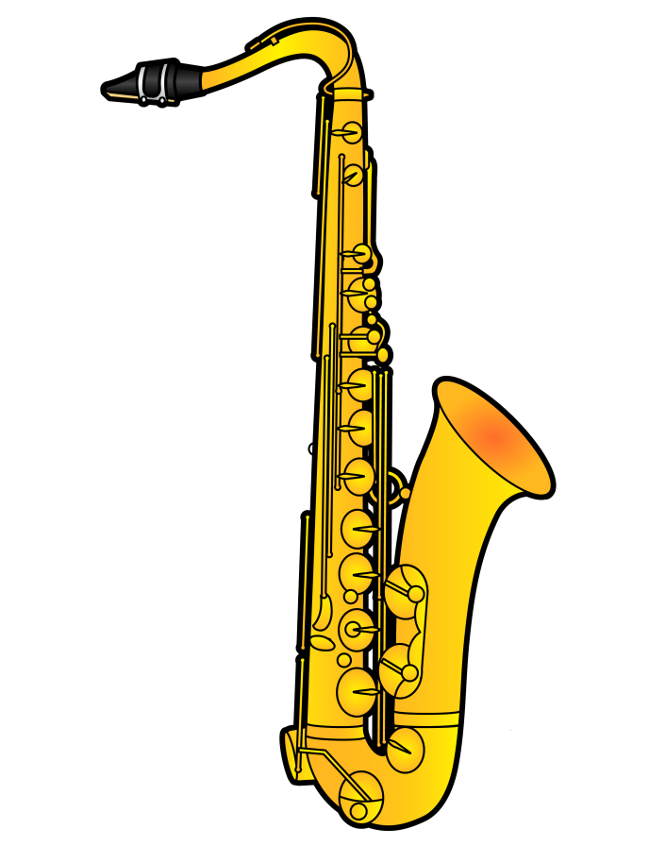
Woodwind Instruments – $300
Name the instrument.

Slide 17
Woodwind Instruments – $300
Name the instrument.
saxophone

Slide 18
Woodwind Instruments – $400
Name the instrument.

Slide 19
Woodwind Instruments – $400
Name the instrument.
oboe

Slide 20
Woodwind Instruments – $500
Name the instrument.

Slide 21
Woodwind Instruments – $500
Name the instrument.
bassoon

Slide 22
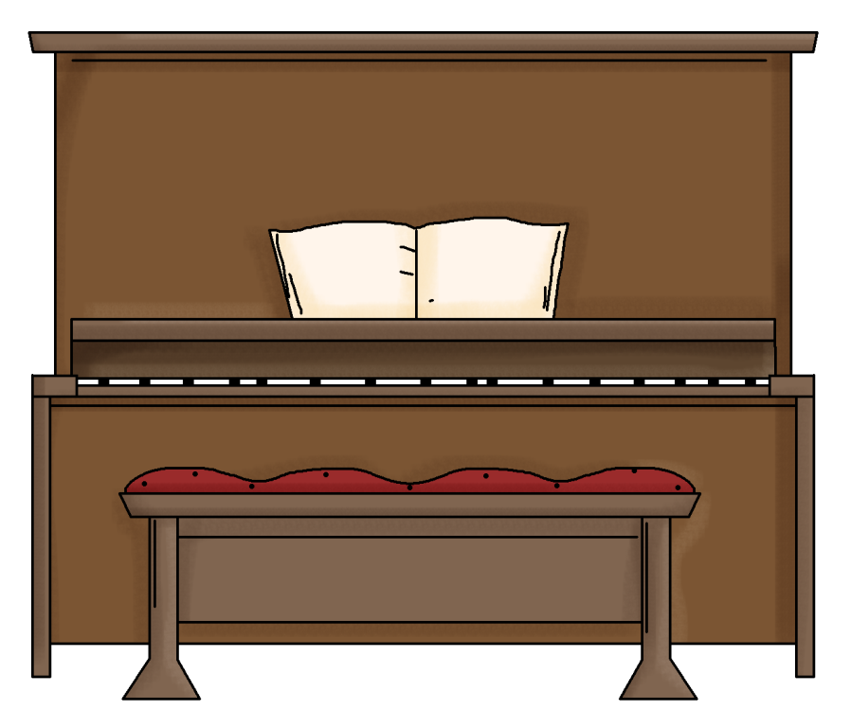
Percussion Instruments – $100
Name the instrument.

Slide 23
Percussion Instruments – $100
Name the instrument.
piano

Slide 24
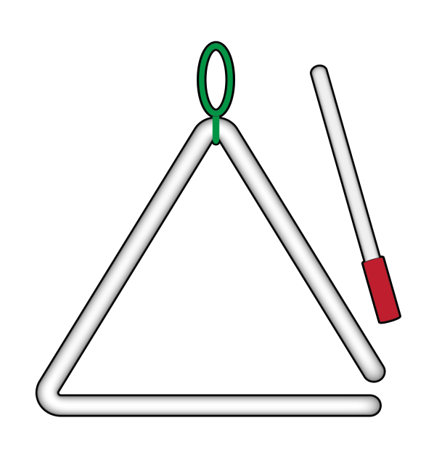
Percussion Instruments – $200
Name the instrument.

Slide 25
Percussion Instruments – $200
Name the instrument.
triangle

Slide 26
Percussion Instruments – $300
Name the instrument.

Slide 27
Percussion Instruments – $300
Name the instrument.
cymbals

Slide 28
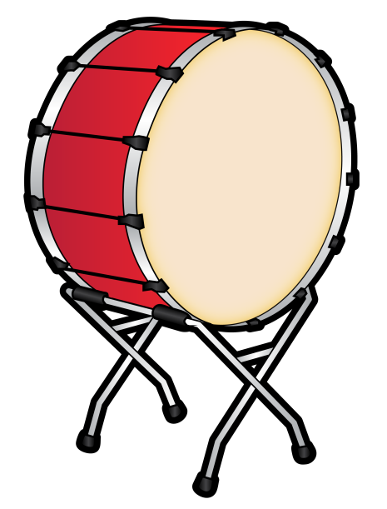
Percussion Instruments – $400
Name the instrument.

Slide 29
Percussion Instruments – $400
Name the instrument.
bass drum

Slide 30
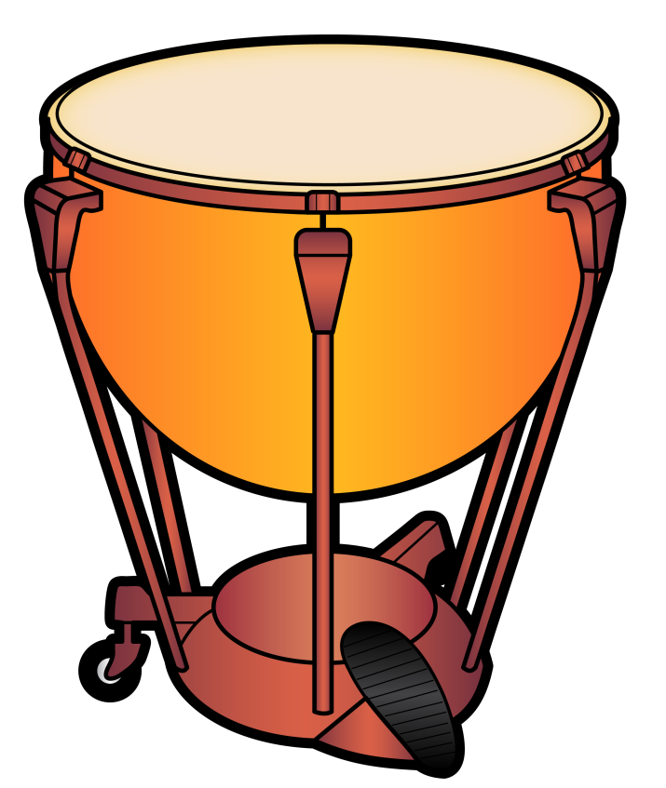
Percussion Instruments – $500
Name the instrument.

Slide 31
Percussion Instruments – $500
Name the instrument.
timpani

Slide 32
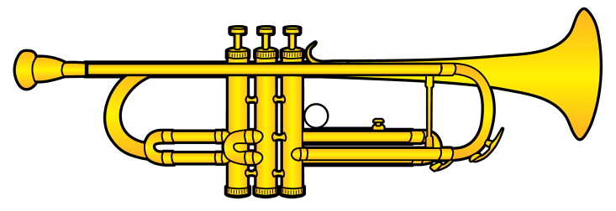
Brass Instruments – $100
Name the instrument.

Slide 33
Brass Instruments – $100
Name the instrument.
trumpet

Slide 34
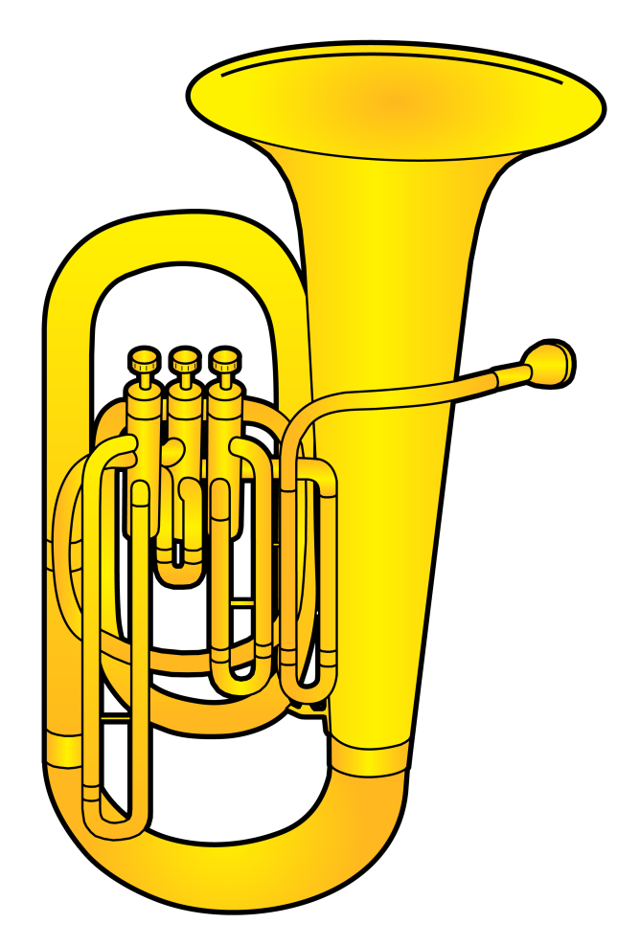
Brass Instruments – $200
Name the instrument.

Slide 35
Brass Instruments – $200
Name the instrument.
tuba

Slide 36
Brass Instruments – $300
Name the instrument.

Slide 37
Brass Instruments – $300
Name the instrument.
trombone

Slide 38
Brass Instruments – $400
Name the instrument.

Slide 39
Brass Instruments – $400
Name the instrument.
French horn

Slide 40
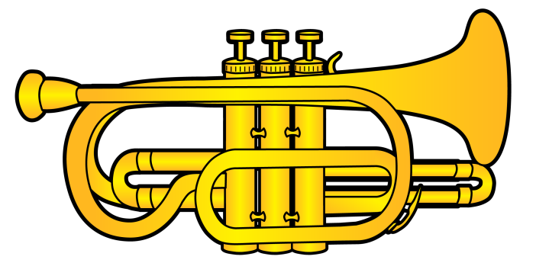
Brass Instruments – $500
Name the instrument.

Slide 41
Brass Instruments – $500
Name the instrument.
cornet

Slide 42
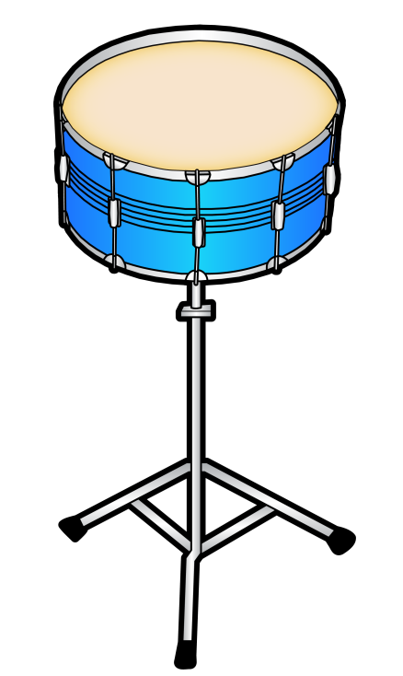
Name the Family – $100
To which instrument family do I belong?

Slide 43
Name the Family – $100
To which instrument family do I belong?
percussion

Slide 44
Name the Family – $200
To which instrument family do I belong?

Slide 45
Name the Family – $200
To which instrument family do I belong?
brass

Slide 46
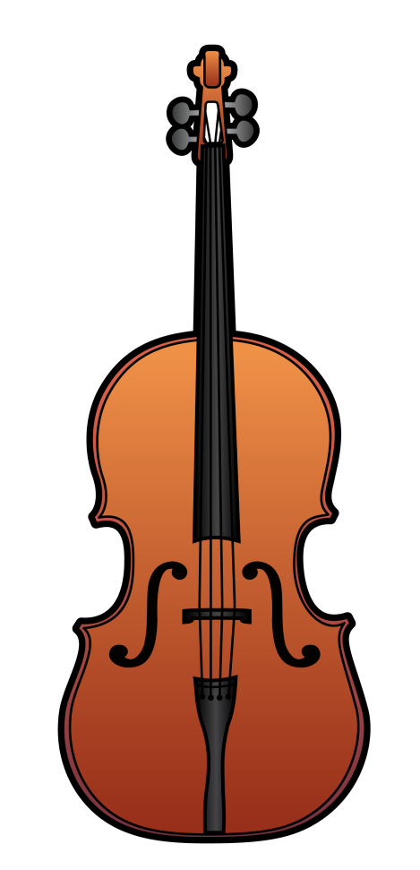
Name the Family – $300
To which instrument family do I belong?

Slide 47
Name the Family – $300
To which instrument family do I belong?
strings

Slide 48
Name the Family – $400
To which instrument family do I belong?

Slide 49
Name the Family – $400
To which instrument family do I belong?
woodwind

Slide 50
Name the Family – $500
To which instrument family do I belong?

Slide 51
Name the Family – $500
To which instrument family do I belong?
percussion

